Slide 1

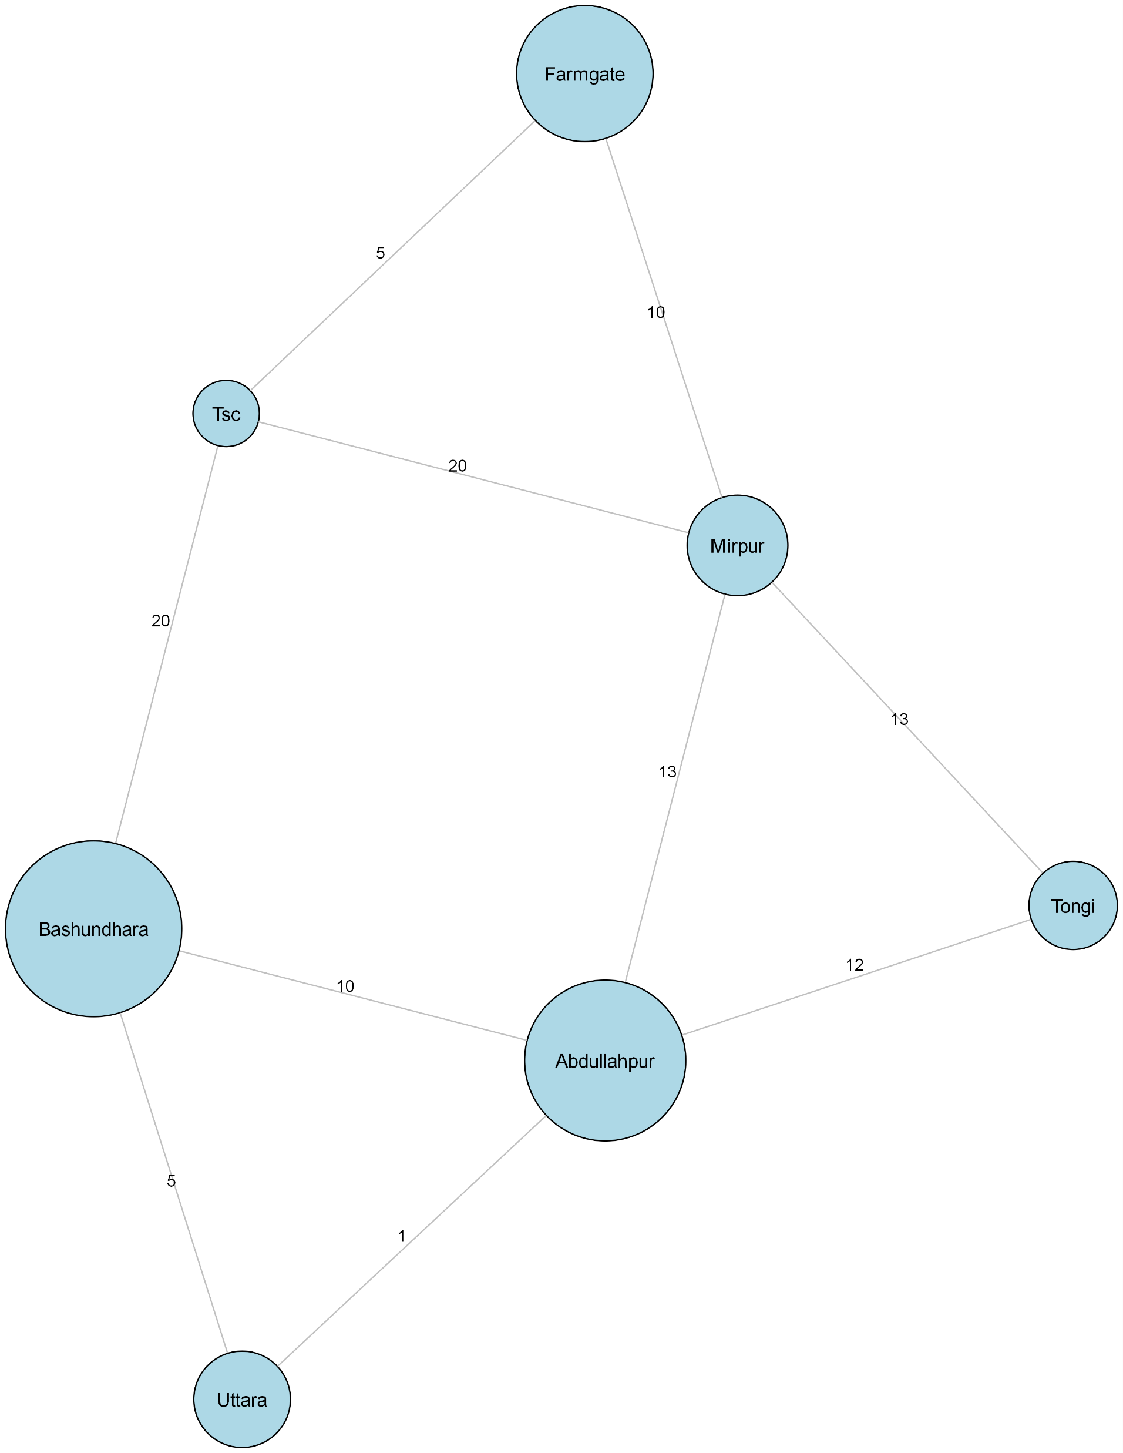
Presented By: 1.Mushfiq Al Jamim(0432320005101013) 2.Khadija Akter(0432320005101011) 3.Sayada Sazia Alam(0432320005101045) 4.Shawon Khan(0432320005101040) Department : CSE Date : 01-06-2025
🚇Dhaka Metro Service software
An Interactive Metro Route & Fare System in C++
🚉
FARMGATE
TSC
🚉
🚉
MIRPUR
🚉
🚉
🚉
TONGI
BASHUNDHARA
ABDULLAHPUR
🚉
UTTARA

Slide 2
🚇What is the Dhaka Metro Service Software?
A C++ Software simulating metro service in Dhaka City.
Calculates shortest routes using Dijkstra’s Algorithm.
Estimates Travel cost and Time.
Interactive travel cost and time.
Interactive features for students and regular users.
Helps Passengers make travel decisions efficiently.

Slide 3
🚇Project Objectives
Simulate Dhaka Metro Network using a graph.
Apply Dijkstra’s Algorithm for optimal pathfinding.
Provide user-friendly interaction.
Estimate fare and travel time.
Simulate real-time scenarios including payment and time selection.

Slide 4
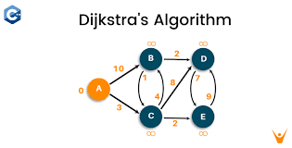


🚇Tools and Technologies
Tools Used:
Programming Language C++.
Data Structures : Map , Set , Vector.
Algorithm : Dijkstra’s Algorithm .
Compilation : Any Standard C++ compiler (e.g. GCC, CodeBlocks ).

Slide 5

🚇Graph Representation
Metro Route as a Graph
Node : Metro Stations.
Edges --> Routes between stations with weights (distance in km).
Example : Farmgate ← 5 Km → TSC Mirpur←13 Km → Abdullahpur .
Compilation : Any Standard C++ compiler (e.g. GCC, CodeBlocks ).

Slide 6
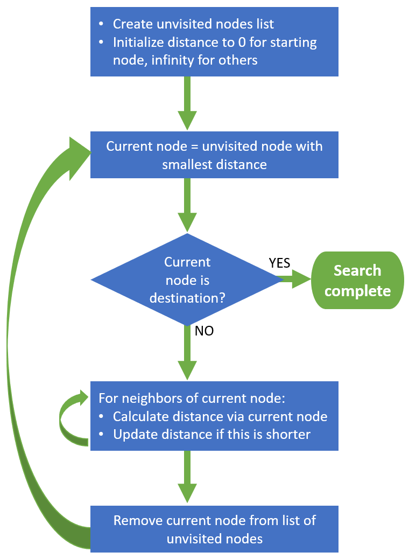
🚇Dijkstra’s Algorithm
Shortest Path Calculation
Dijkstra’s Algorithm finds the shortest path from source to destination.
Tracks visited nodes and updates minimum distance.

Slide 7
🚇Core Features
Features of the software
Dynamic Graph Building.
Route printing and visualization.
Ticket Cost estimation.
Student Discounts
Estimated Travel time based on average speed.
Payment and coin change system.
Timetable simulation

Slide 8
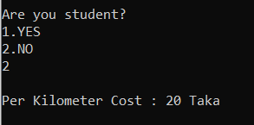
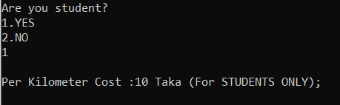
🚇Fare Calculation
Ticket Cost System
Regular Fare 20 Taka/Km.
Student Fare : 10 Taka/km.
Example : 10 Km trip : Regular : 200 Taka Student : 100 Taka.

Slide 9
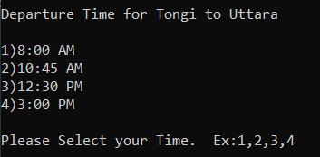
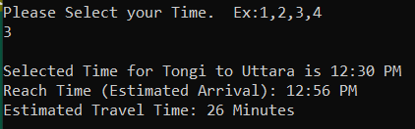
🚇Time Estimation
Travel Time and TimeTable
S = VT T = S / V Travel Time = Distance/Velocity.
Average speed = 30 km/h.
User Chooses Departure Time.
System calculates estimated arrival time

Slide 10

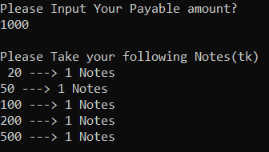
🚇Payment Simulation
Payment and change Calculations
User Inputs Amount Paid
System breaks down the change in available currency denominations.
Simulates real-world transection.

Slide 11
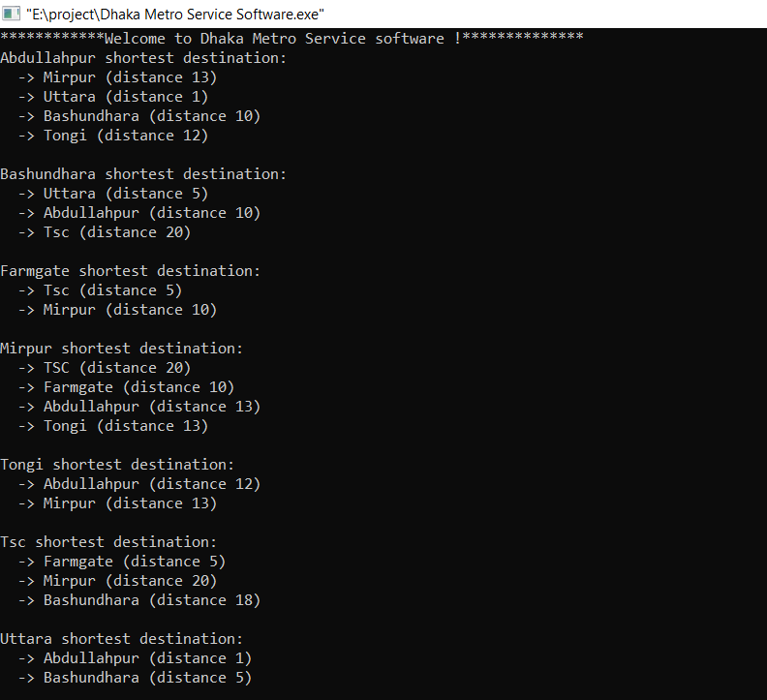
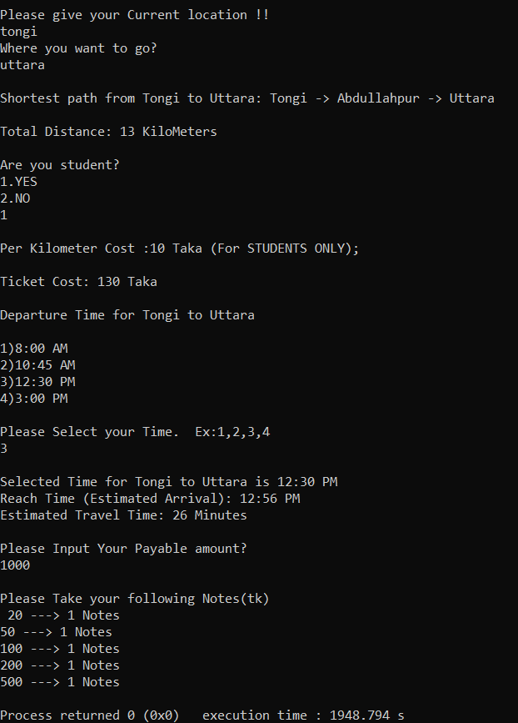
🚇Demo/Output Screens

Slide 12
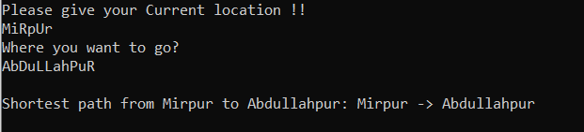
🚇Challenges Faced
Handling string case sensitivity (e.g. “Mirpur” vs “ MirpuR” )
Managing an intuitive interactive Console Flow.
Graph Representation accuracy.
Edge cases in input handling.

Slide 13
🚇Conclusion
summary
Successfully simulated Dhaka metro System.
Implemented Dijkstra for Efficient Routing.
Integrated fare system , time scheduling and payment simulation.
Ready for real-world use Cases.

Slide 14
🚇References
Books and Algorithms :
“Data structures and Algorithms Made Easy by Narasimha Karumanchi ”-Dijkstra’s Algorithm.
GeeksforGeeks — Explanation and implementation of Dijkstra’s algorithm.
CPPReference.com — Standard C++ Library Reference
Tools and Platforms :
Code::Blocks-C++ development Environment.
GCC(GNU Compiler Collection)– C++ compiler
Data and Context :
Wikipedia
Google Maps
Speacial Thanks to OUR Instructor Saima Siddique Tashfia !!

Slide 15
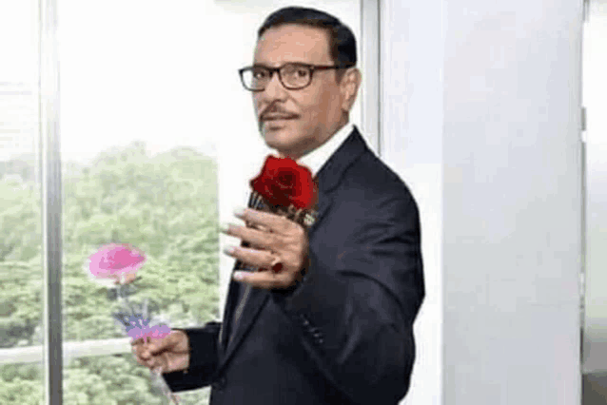
🚇GitHub
LINK - https://github.com/MuushfiQ/DSA-PROJECTS/
Good ByE!!!!

